Slide 1

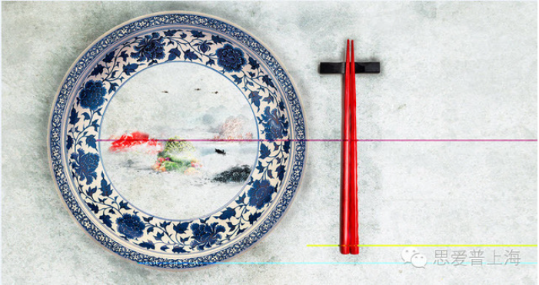
Digital Meal Service

Slide 2
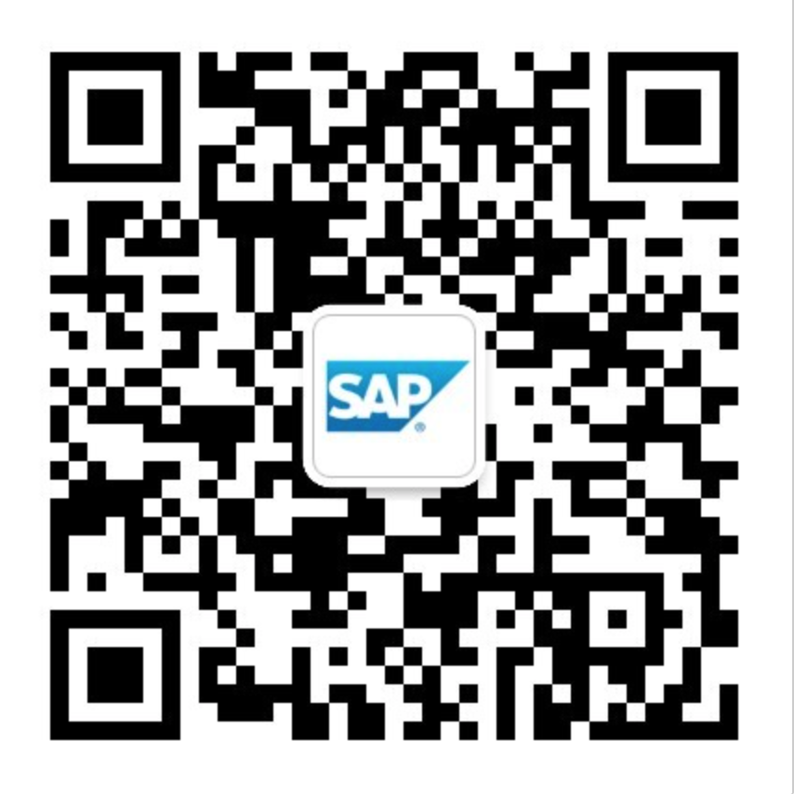
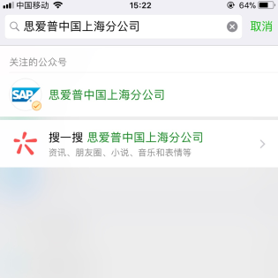
1. How to subscribe the We-chat Enterprise Account which provide the services application?
Option 1: Scan the QR Code below to subscribe it
Option 2: Search our Enterprise account by name “思爱普上海分公司”
in We-chat and then follow it.

Slide 3
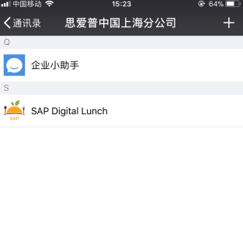
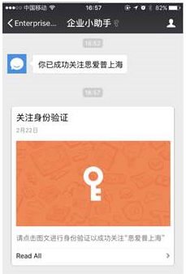
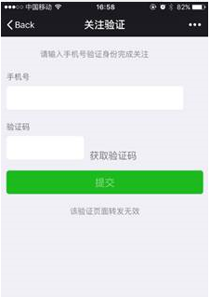
2. How to pass the identification verification?
If the cell phone which you’ve provided has
already bound your We-chat account, you will
directly subscribe successfully
Otherwise, it will lead you to an verification
page in the “企业小助手”. Input your phone
number and provide the verification code
which you received

Slide 4
Comments:
Please be noted: the “企业小助手” is a native built-in application of the We-chat platform which is used
to send system information to you. Unfortunately it only supports Chinese at the moment.
But don’t worry, there are only 2 scenarios you might meet when you subscribe our Enterprise We-chat
Account for the first time.
When you received “你已成功关注思爱普上海分公司”
It indicates: you have follow our We-chat Enterprise account successful.
When you see “关注身份验证”
It indicates: you need click this message to pass the identity verification by input your mobile number
and the verify code which you will receive later.
The easiest way is: go for any one of your Chinese colleagues around you, he/she will help on that.

Slide 5
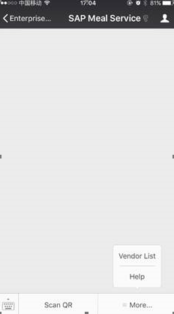
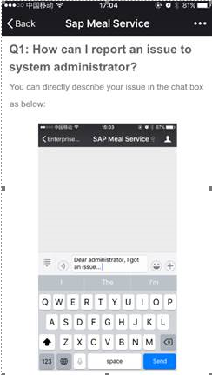
3. How to use the meal service application?
Find the We-chat Enterprise account
in your address book or in your chat
history; move into the SAP Meal
Service application and then press
the [Scan QR] button to consume lunch.
Click the [More…] button, the Vendor
List function will show you the
contracted vendor list
Once you got any problems, you can
directly describe and send it in the
‘SAP Meal Service’ application’s chatbox.

Slide 6
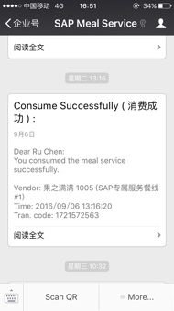
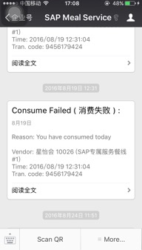
5. Example
If the code successfully, you will receive a message on the WeChat.

Slide 7
6. Policy
According company`s policy, meal service is only for the employee who
work at office, not for those on leave or travelling, or other condition
not in the office.
* Every person just can choose one place to have lunch from three places.
PVG 04 Kitchen, PVG 06 Kitchen, Outside Vendors.
We will check the duplicator every day.
* Employee just scan QR on the spots, the screenshot QR could not be accepted.
* The service time of Digital Lunch APP is 11:30am ~ 2:00pm, only for working days.
Maybe it will bring some inconvenience, but it really ensure Food App
run smoothly and fairly. Thanks for your understanding and supporting.
If have any questions, pls. contact with Joyce Zhang C5296685.

